Slide 1


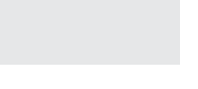






Overview
FORWARD III | October 15th - 16th | Bellagio | Las Vegas
July 24, 2019
Mary Tetlow

Slide 2

Forward: Our Story, Our Ambition
FORWARD III | October 15th - 16th | Bellagio | Las Vegas
We have a tribe.
Our tribe comprises a global group of RPA adopters, evangelists, explorers, prospectors, and intrepids across the spectrum. It includes those who are inspired by the promise and practice of automation first–and those who seek that inspiration. Those who have achieved amazing things using UiPath technology–and those still searching for a pathway.
FORWARD gathers our tribe together each year, allowing us to deepen connections, strengthen purpose, explore and learn, and draw audacious inspiration from each other.
Like Cannes or Sundance in entertainment, or Davos in world affairs and industry, FORWARD serves as a center of gravity in the RPA world – a widely anticipated annual event supporting and celebrating the visionaries and groundbreakers who are moving the 4th Industrial Revolution forward. It’s where we acknowledge the most fulfilling journeys and the most profound triumphs in the RPA universe, and unveil the most important new discoveries, inventions, trends, and news. It’s a safe space to ask questions, gain knowledge, and perceive new possibilities.
Of importance, FORWARD is not about UiPath. It’s about what UiPath enables our tribe to do. It’s how we make people impatient to forge their path to the future, using our technology to change work in meaningful, inspiring, and surprising ways. It’s about how we enable them to Reboot Work.

Slide 3
FORWARD III | October 15th - 16th | Bellagio | Las Vegas

Slide 4
Purpose
FORWARD III | October 15th - 16th | Bellagio | Las Vegas
This is primarily an event to drive UiPath footprint expansion in installed base customers. It’s also a pipeline-accelerating event for current customers and pipeline prospects.

Slide 5
FORWARD III | October 15th - 16th | Bellagio | Las Vegas
Strategy
Convene the UiPath “tribe” – the whole community – in a buzzing, high-spirited and joyful experience, to forge the future of RPA, strengthen relationships, share knowledge, display our RPA thought-leadership, share roadmap and future plans.
Provide our customers content and experiences that enrich both their professional and their personal lives.

Slide 6
FORWARD III | October 15th - 16th | Bellagio | Las Vegas
Vision
To be the can’t-miss-it RPA event of the year for any current RPA practitioner or those considering it, and anyone intent on moving forward– forward on a digital transformation journey, forward on making work more joyful, forward on taking the first steps toward realizing their full potential.

Slide 7
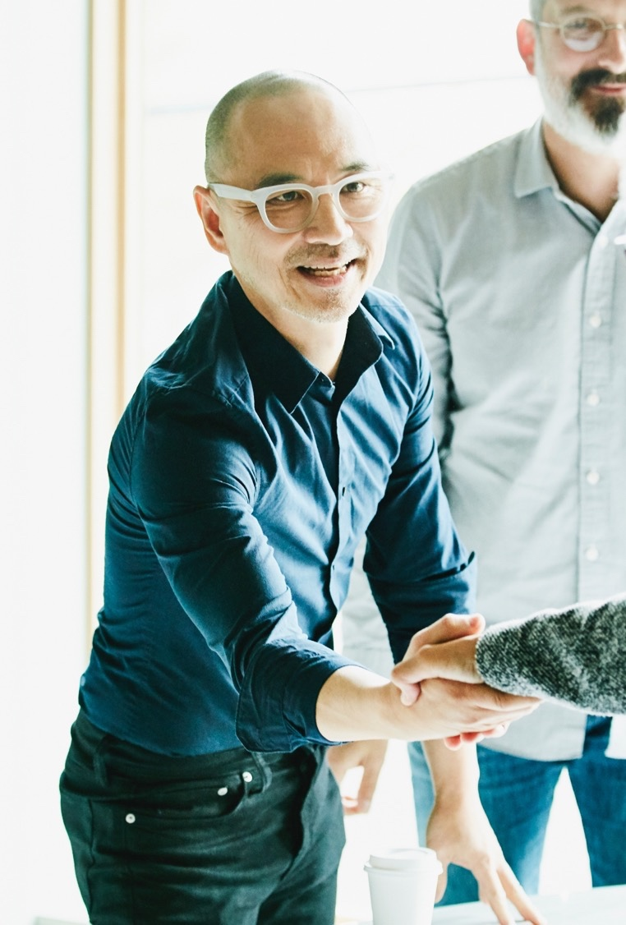




Some Desired Takeaways
FORWARD III | October 15th - 16th | Bellagio | Las Vegas
I am so glad I made the time to attend FORWARD! I got something out of it for myself and for my company.
There was such a great energy at this event.
I met incredible people who are using RPA in ways we hadn’t considered.
I truly understand what it means to think automation first.
I believe UiPath cares about me.
I’m part of a community that is helping to make work more inspiring.
UiPath is so innovative and accessible—I’m glad they are our RPA provider.
We should think differently about how we work. Let’s find ways to provide more robots across our company.

Slide 8



Event Fundamentals
FORWARD III | October 15th - 16th | Bellagio | Las Vegas
WHAT
Keynote Main Stage; business and technical tracks
A bustling expert village with both partner sponsors and UiPath expert booths, spaces for informal meetings, baristas, premium snacks, R&R area; Speakers Corner
Time built into the agenda (“Meet the Experts”)
Speaker booth to ”Meet the speaker” after presentations
We begin and end with customers: spreadsheet created a month ago to collect candidates and stories – keep it coming: https://docs.google.com/spreadsheets/d/1L4jlZtGguvC7CpNgDJoN6AmZpuNWsVIkKMCuRxD0AIs/edit
Seated, plated lunches for increased networking and fellowship and focused topic tables that can be offered as sponsor offerings
Academy Live sessions

Slide 9
Event Fundamentals
FORWARD III | October 15th - 16th | Bellagio | Las Vegas
WHAT
Partner Forward
theCUBE
Pre-conference cocktail reception October 14th (6 PM-8 PM)
Celebration evening of the 15th
External keynote speakers including the Economist Intelligence Unit editor presenting our automation maturity research
NO “VIP” anything – Every Customer is a VIP
Press/influencer/analyst briefings
Private meeting rooms/suites
Global CAB Event
Securities/investor meeting on Oct 14
Poker with Diego “Nothing up my sleeve” Lomanto
GREEN event

